Slide 1
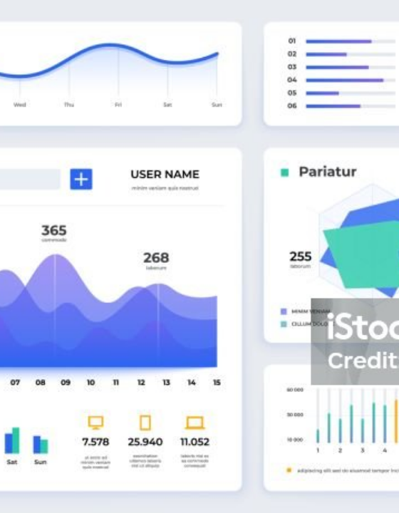
DATA ANALYTICS PROJECT
Food Ordering Behaviour & Consumer Trends
Transforming raw transactions into actionable business intelligence.

Slide 2

The Business Challenge
Predict Demand: Anticipate peak operational periods.
Map Regions: Identify regional cuisine preferences.
Target Demographics: Align restaurant tiers with age groups.
Monitor Logistics: Track delivery fulfillment speed.

Slide 3

Data Preparation Foundation
Processing the core dataset for visualization.
50,000 Transactions
Feature Engineering
Quality Assurance
Historical order values and operational timing data.
Custom age bins and delivery time intervals.
Strict type casting and core baseline aggregations.

Slide 4
PLATFORM PERFORMANCE METRICS
50K
₹2.73Cr
₹548
2.99
Total Orders
Total Revenue
Avg Order Value
Average Rating

Slide 5
Regional Insights
Demographic Insights
Market Leaders
Core Audience
Mumbai and Pune dominate total order volume.
20s and 30s cohorts drive mid-range restaurant sales.
Peak Categories
Premium Scaling
Desserts and fast food peak significantly on weekends.
Premium tier orders scale upward with older age groups.
Consistent Demand
Social Dynamics
Biryani order volume remains universally high everywhere.
Time of day dictates volume far more than party size.

Slide 6



Operational Realities
Baseline Satisfaction
Consistent 2.99 average rating across all meal types.
Delivery Curves
Standard bell curve highlights outlier delay intervals.
Menu Optimization
Budget segment requires aggressive fast food inventory.

Slide 7

Flask Web Deployment
Lightweight Python backend routing logic.
Tableau Embedding API secure components.
Zero-install direct stakeholder web access.
Fully interactive HTML portal interface.

Slide 8
Data-Driven Delivery
Translating raw historical transactions into targeted, actionable business strategies.
Vansh Jaisinghani • Data Analytics

Slide 9



Image Sources
https://media.istockphoto.com/id/1159848977/vector/dashboard-ui-modern-presentation-with-data-graphs-and-hud-diagrams-clean-and-simple-app.jpg?s=1024x1024&w=is&k=20&c=dkB3MThs0OlnLe3BzYOF2k2OTf3CEI3lTAQSEfLuM-U=
Source: www.istockphoto.com
https://en.pimg.jp/085/384/776/1/85384776.jpg
Source: tw.pixtastock.com
https://cdn.educba.com/academy/wp-content/uploads/2019/10/Abstract-Class-in-Python.jpg
Source: www.educba.com

